Slide 1
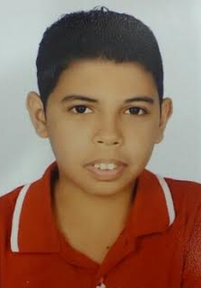
Curriculum Vitae
CAREER OBJECTIVES :
To join an Organization which provides challenging opportunity in which I can grow and prove my skill , and work in an environment that is only demanding but also offering potential for professional & personal growth.
PERSONAL DETAILS :
Name : Yusuf Ahmed Jaffar Ahmed Ali Edheem
Nationality : Bahraini
Address : villa 4153 Road 4570 Block 645 Hawrat Sanad
Civil Status No. : 961209801
Date of Birth : 29 / 12 / 1996
Gender : Male
Marital Status: Single
Contact No : 33920051
EDUCATIONAL QUALIFICATIONS:
General Secondary School certificate
LANGUAGES :
Arabic
English
SKILLS :
Computer .
Communication skills .
Dealing with Customers .
Handle speed .

